Slide 1
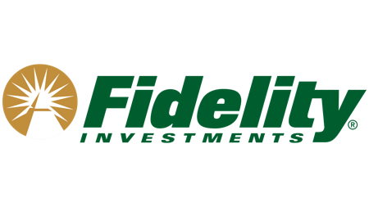
Fidelity Labs and the Digital Transformation of Fidelity Investments
MIS 581 HBP Team Case Study
Woo Sox Team
Allyson Bernard,
Shubham Chaudhary,
Harsh Deshpande,
JAYESH HARYANI

Slide 2
Agenda
Overview of Fidelity Investments
Innovation Challenges
Abby Johnson
Technology Challenges & IT Leadership
Enablers & Challenges
Our take on CIO Leadership
Cultivating Your Environment
Fidelity Labs
Opportunities from and IT Perspective

Slide 3

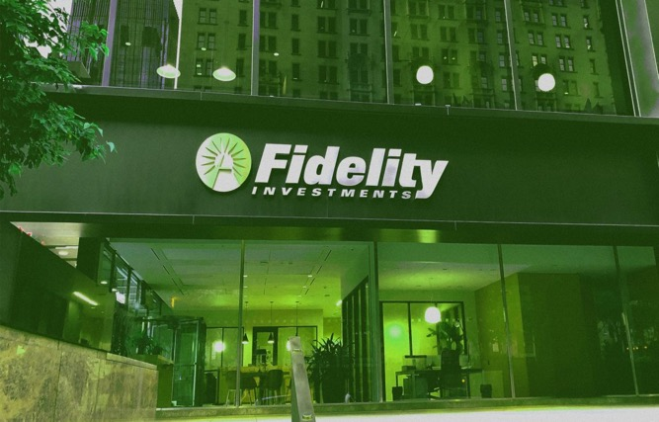
an overview of the current state of Fidelity
Foundation of fidelity
Present state of fidelity
Founded by Edward C. Johnson in 1946.
Firm purchased its first computer 1965.
Followed by the first mutual fund firm mobile app, in 1998.
More than 43 million individuals.
Transition from paper to digital.
Techniques such as AI, including machine learning applications for the Big Data.
Notes:
- Fidelity Investments (aka Fidelity) was a privately owned investment management company that was founded by Edward C. Johnson II in 1946 as a mutual fund company.
In 1965, the firm purchased its first computer that occupied nearly an entire building floor, so we can se how way ahead fidelity was before the others.
Fidelty became the first company to launch their mutual fund mobile app in 1998. I also invest in mutual funds and its 2024 even today I just use a mobile app for that, its shows how fidelity was way advanced from their rival companies.
Fidelity is using techniques such as AI, including machine learning applications for the vast amount of data that generates daily. So with the help of these techniques, they are managing their company and taking it to new heights
Class reference(internal): Transition from paper to digital- Just a few days back, we had our guest speaker David Wolf, the CPO of the company, who told us that their office has eliminated printers entirely. They are actively transitioning from a paper-based working to a digital platform. Which shows how fidelity is changing is data base to digital means.
Outside References:
Feyen, Erik, et al. Fintech and the Digital Transformation of Financial Services: Implications for Market Structure and Public Policy. July 2021.
‌

Slide 4



Challenges in innovation for fidelity
Customer Trust
Competition
Regulatory Compliance
"Every change is a challenge"
Notes:
Personal story- During my work experience in India, I was working on a house that I was building for a client. We had decided on the design and final look of the project, and when it was finished, the final look and design matched our client's expectations, and his family really liked the house. This helped us earn their trust, which in turn helped us get more projects in the future as our clients recommended a few of their friends to our firm. That’s how we build our customers’ trust.
Customer trust - In the financial industry, trust is paramount. Shifting from traditional human advisory services to technology-driven solutions is a great change for the company as well as the clients. Fidelity must ensure that the new systems are reliable and secure. Building and keeping trust in these systems might take some time, and it's a step-by-step process.
Regulatory compliance – due to rapid technology advancement it’s very difficult to keep up with the enforcement of regulations as it may lead to Data Privacy of the clients as well as Cybersecurity concerns. To overcome the difficulties of following the rules while using new technologies, fidelity needs to be proactive. This means taking steps ahead of time to understand and meet the regulations.
Competition – the emergence of new tech focused startups, can quickly adapt to the market changes and give tough competition to the traditional institutes like fidelity. These startups may acquire the top tech talent, like data scientists, and experts so retaining these talents is also a big task for institutions like fidelity.
Cultural Shift-Moving from a model where expert knowledge and personal relationships were key to a more tech-driven, data-centric approach can be met with resistance internally.
Recruiting and Keeping Talent- Attracting and retaining top tech talent, data scientists, and experts in emerging technologies is crucial for successful innovation. Competition for such talent is fierce, and traditional financial institutions may face challenges in offering the same dynamic work environment as startups
Outside Ref:
“About Fidelity - Our Company.” Www.fidelity.com, www.fidelity.com/about-fidelity/our-company.

Slide 5
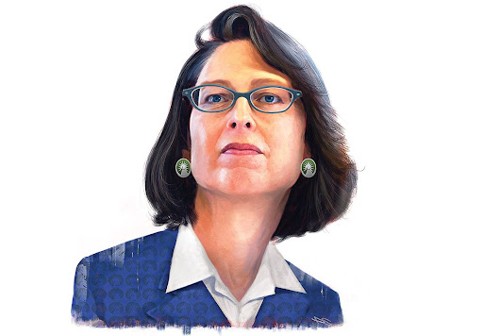
Abby Johnson as the Ceo and president
Abigail Johnson is a proactive and visionary leader who successfully steered Fidelity through a transformative journey towards digitalization and innovation. Several points to highlight her effectiveness are -
^{Embracing Innovations}
Continuing a Legacy of Innovation
^{Strategic Leadership}
Adapting to Industry Challenges
"My Biggest challenge has been to push Fidelity to increase our pace of innovation and to not make the occasional mistake"
- Abby Johnson
Notes:
Q - What do you think of Abby Johnson as CEO and President of Fidelity to lead this transformation?
A - Based on the information provided in the case study, Abigail Johnson appears to be a proactive and visionary leader, successfully steering Fidelity through a transformative journey towards digitalization and innovation. Several key points highlight her effectiveness:
Embracing Innovation
Continuing a legacy of Innovation
Strategic Leadership
Adapting to Industry Challenges
Customer-Centric Approach
Outside Resource -
“Fidelity’s Abigail Johnson’s Journey to CEO.” Www.youtube.com, www.youtube.com/watch?v=yAaJxi1xcow.

Slide 6

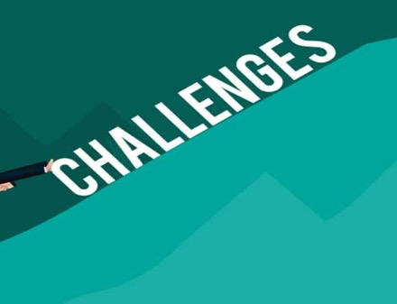
The Enablers and challenges
Enablers
Challenges
Investment in Technology
Agile Development Process
Open Work Environment
Leadership Support
Legacy Sytems and Processes
Balancing Innovation with Caution
Talent Acquisition and Retention
External Disruption
Notes:
Q- What do you think about Fidelity's culture to pull off this transformation? What enablers and challenges do you see?
Fidelity's culture appears to be a critical enabler for the successful transformation outlined in the case study. Several aspects contribute to the positive culture supporting innovation, but there are also potential challenges that need to be considered:
Enablers-
Investment in Technology
Agile Development Process
Open Work Environment
Leadership Support
Challenges -
Legacy System and Processes
Balancing Innovation with Caution
Talent Acquisition and Retention
External Disruption
External Resources-
https://www.forbes.com/sites/stephenwunker/2023/05/24/how-fidelity-became-a-business-leveraging-start-ups-jobs-to-be-done/?sh=6aeda93e8f87

Slide 7



If I wERE THE CIO...
Stop projects with no future
STAY CUSTOMER FOCUSED
Build an inclusive community
"Take chances and make your own luck."
-Mona Vernon, Head of Fidelity Labs
Notes:
Q: IF YOU WERE THE CIO OF FIDELITY, WHAT WOULD YOU DO THE SAME OR DIFFERENT?
Fidelity Investments has proven itself as an innovative investment company with many factors leading to this success.
Continue developing new technology products with Fidelity Labs to keep top talent engaged and solve customer driven, user focused problems.
Focus on engaging with new markets with products like Fidelity Go to keep Fidelity a relevant name for emerging generations.
Be willing to stop projects that are not proving to add value, such as with blockchain or Google Glass apps.
Q: WHAT WOULD KEEP YOU UP AT NIGHT AND WORRIED?
There are many things to keep a CIO up at night including the following reasons.
Maintaining an innovative and inclusive community that attracts and engages top talent.
Manage the ever-shifting technology landscape to understand growing trends and how to capitalize on opportunities strategically.
Class material Resource:
"Take chances and make your own luck," Mona from the Tech on Deck podcast
IT Leadership needs to understand that these successes are not happening overnight and by accident. Instead, one needs to make their own luck by taking changes, keeping strong employees around, and continuing the work that is working. It seem like Fidelity has just been lucky, but it in truth they have been taking chances and building a collaborative environment for years.
“‎Tech on Deck on Apple Podcasts.” Apple Podcasts, 5 Dec. 2023, podcasts.apple.com/us/podcast/resiliency-in-a-complex-tech-environment/id1678031913?i=1000637529043Links. Accessed 31 Jan. 2024.

Slide 8


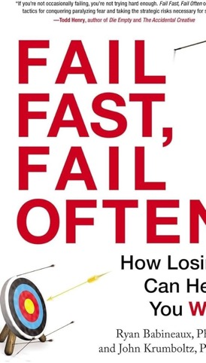

Cultivate your environment
Establish Candor with Care
Establish communication channels
Encourage Failing Fast and Failing Often
Acknowledge Accomplishment, Milestones, and Success
Notes:
Q:If you were an IT department head, what would you think about this approach and how would you engage/support/enable this locally in your own department and team members?
A: Cultivating your environment is so very important and something you can work to improve at all levels. Providing candor with care, having well defined communication channels, encouraging failing, and acknowledging success can be done by all members of your team, but a supportive leadership team that demonstrates these values is priceless. We had the chance to read how Fidelity leadership, and especially Abby Johnson demonstrate these values and can serve as guide to basic interactions across the organization.
Personal Story:
Early in my career I had the opportunity to work with an outside consultant to help my new team establish basic ground rules for dealing with change and Candor with Care was the mantra that I've continued to bring with me. This phrase helps remind me to assume positive intent and approach challenging situations with my colleagues in mind. It also reminds me that having difficult conversations is hard, but it allows the whole team to benefit from growth.
Outside Resource:
Fail Fast, Fail Often is a useful phrase to stay in the Agile mindset. The focus is to continually iterate, make progress, fail, and then iterate again until you have a product that fulfills your business requirements.
Babineaux, Ryan, and John Krumboltz. Fail Fast, Fail Often. Penguin, 26 Dec. 2013.
‌
‌

Slide 9




Fidelity Labs
Strategy Approach & Standard Practices
Incubate New Businesses
Teach and Share Innovation
Research The Future
Stress Test New Technology
Notes:
Q1) What do you think of their strategy approach and the Fidelity Labs adopted standard practices mentioned in the case?
A1) I think Fidelity's strategical approach and the standard practices that Fidelity Labs adopted are great. Fidelity labs was created in 2005 as an in-house incubator that allowed them to rapidly develop new products and businesses. They also made use of the previously established FCAT (Fidelity center for applied technology), the purpose of which was to help the lab in the ideation and innovation process. With the help of fidelity labs, entrepreneurs and businesses could enter the market ready to fight, it is almost as if they got a headstart when compared to other nascent startups. And it's not just about being an incubator for startups, we should also keep in mind that fidelty stressed a lot on the technology side of it and this was in 2005 so when technology truly did boom, the startups which had already done their research and testing in technology, got an advantage later down the line. Along with all of this, Fidelity labs also stressed on design thinking, lean startup and agile development, all of which in my opinion are great standard practices.
There is company called Saifr which was also born in Fidelity Labs. Talk more about this
Outside Reference:
“Saifr: A Startup with 15 Years of Experience | Saifr.” Saifr.ai, saifr.ai/blog/saifr-a-startup-with-15-years-of-experience.

Slide 10





Opportunities from an it culture standpoint
Embracing innovation
Customer-centric design thinking
Talent development
Agile and Rapid product development
Leveraging blockchain and digital assets
Notes:
PERSONAL STORY:
In my undergrad years, in India, I worked with a startup called 'Scientific Interstellar' who wanted to design a safety device that can help victim by alerting the police and their emergency contacts in a threatening situation. We had to come up with something very customer centric because if you think about it, no one would want to wear a silly looking device on them. Talk more about this in video
Class reference:
Jim Maholic, and Jud Brandt. IT Strategy : A 3-Dimensional Framework to Plan Your Digital Transformation and Deliver Value to Your Enterprise. United States, Jim Maholic, 2019.
Q2) What opportunities do you see from an IT culture standpoint?
A2) From an IT culture standpoint, there are several opportunities evident in the case of Fidelity:
1. Embracing Innovation: Fidelity Labs has adopted a philosophy of "thinking big, moving quickly, and failing fast" to create impactful innovations. This approach encourages a culture of experimentation and learning from failures, so basically you have an environment where IT teams can explore new technologies and solutions without fear of failure.
2. Customer-Centric Design Thinking: Fidelity focuses on customer-centric design thinking. So they know the importance of understanding and meeting customer needs. This approach presents an opportunity for IT teams to align their efforts with customer expectations, which results in the development of user-friendly and impactful digital solutions.
3. Talent Development: Fidelity is known to invest in recruiting top tech talent and creating innovative workspaces, like the "7th Floor Village". Basically they have a commitment to nurture a culture of creativity and collaboration among technologists. This encourages employees to learn and develop continuously.
4. Agile and Rapid Product Development: Fidelity emphasises on pace over perfection and rapid product development. Naturally, this presents an opportunity for IT teams to adopt agile methodologies and streamline their development processes. This is extremely useful for an organization that wants to develop fast but keep its quality consistent. This Agile approach makes use of the 4 foundations which are Current State, Future State, Assumptions & Risks and Transformation Roadmap
5. Leveraging Blockchain and Digital Assets: Exploration in blockchain technology and digital assets, in my opinion, creates one of the best opportunites from an IT point of view ini today's world. Fidelity has also partnered with Coinbase, so this presents an opportunity for IT teams to delve into cutting-edge technologies and stay on top their game in the financial services industry.

Slide 11
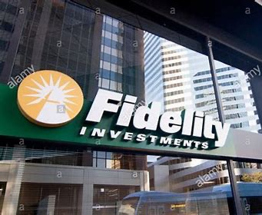
conclusions
Seek opportunities that place value on a culture that prizes innovation, challenge, and positivity
Demonstrate leadership at any level
Leverage the Agile methodology to tackle technology projects and adapt as projects change
Stay open to emerging technologies and innovations
Notes:
Fidelity has embraced a unique approach to the fintech industry and their commitment to culture is admirable.
Going forward...
We will look for opportunities that value positive culture, innovation, and embracing challenge
We will approach organizations with an understanding that we can be leaders at any level
We will keep an open mind about new technologies and innovations, even if we don't understand their initial application fully, like blockchain
Why & How did we find this?
Fidelity Investments has a positive reputation in our community, whether it is from current/past employees, this case study, or their attendance at WPI programs. After learning more about the Fidelity Labs and how they take chances on emerging technologies and are a "Technology company that does finance," we felt their approach to be refreshing and the type of place we would want to work at. When we looked at our own personal stories, especially, there seemed to be a lot of overlap of our own personal values and experiences with Fidelity's approach.

Slide 12
Thank you!
Any questions?

Slide 13
References
Babineaux, Ryan, and John Krumboltz. Fail Fast, Fail Often. Penguin, 26 Dec. 2013.
‌“‎Tech on Deck on Apple Podcasts.” Apple Podcasts, 5 Dec. 2023, podcasts.apple.com/us/podcast/resiliency-in-a-complex-tech-environment/id1678031913?i=1000637529043Links. Accessed 31 Jan. 2024.
‌ “Saifr: A Startup with 15 Years of Experience | Saifr.” Saifr.ai, saifr.ai/blog/saifr-a-startup-with-15-years-of-experience. Accessed 2 Feb. 2024.
“About Fidelity - Our Company.” Www.fidelity.com, www.fidelity.com/about-fidelity/our-company.
‌Feyen, Erik, et al. Fintech and the Digital Transformation of Financial Services: Implications for Market Structure and Public Policy. July 2021.
Digital Transformation of Financial Services: Implications for Market Structure and Public Policy. July 2021.
Maholic, Jim, and Jud Brandt. It Strategy: A 3-Dimensional Framework to Plan Your Digital Transformation and Deliver Value to Your Enterprise. Jim Maholic, 2019.
“Fidelity’s Abigail Johnson’s Journey to CEO.” Www.youtube.com, www.youtube.com/watch?v=yAaJxi1xcow.
https://www.forbes.com/sites/stephenwunker/2023/05/24/how-fidelity-became-a-business-leveraging-start-ups-jobs-to-be-done/?sh=6aeda93e8f87

Slide 14
Required Case Study Check List If this is not filled out, you will automatically receive a zero for this assignment submission You must answer all case study items (1-8) for the “Yes/No” column and also complete the detail information for all required green boxes below unless it says “N/A”
Case Study Items | Yes/No | What slide(s) is your proof of this in your submission? | Proof in your the slide(s) or notes section?
1. Did you review the detailed rubric after you completed this assignment to make sure you covered everything? | Yes | N/A | N/A
2. Did you review all detail/specific and overarching questions in the assignment to make sure you covered everything? | Yes | N/A | N/A
3. Did you do a conclusion slide(s) to answer all required conclusion items/questions? | Yes | 11 | Yes
4. Did you a create reference slide in the proper MLA format? | Yes | 13 | Yes
5. Did you test all your links for references and/or files so a reader can just click to see your materials? | Yes | N/A | N/A
6. Did you proof-read all your slides, attachments, links, notes, etc. before your submission? | Yes | N/A | N/A
7. For your reference slide, did you have internal and external resources/materials to our course? | Yes | 3, 4, 5, 6, 7, 8, 9, 10, 12 | Yes
8. Did you share your own personal stories, thoughts and explain the “Why” your answers are important to you? | Yes | 4, 8, 10 | Yes

